Slide 1
As Seen Advertised
BIA – 660 Final Project
Frank Consentino
Jennifer Meidl
Qi Zhu

Slide 2
Introduction
Our company “As Seen Advertised” is looking for a new method to advertise to increase brand awareness as well as market share.
Our Goal is to convince our Executive Management team to try a new method of Advertising.
We analyzed three methods of advertisements:
TV Broadcasting
Super Bowl
Viral
We will prove which type of marketing campaign is most effective in gaining market share/brand awareness by:
Analyzing Tweet Sentiments and YouTube comments
Comparison analysis of all three types of advertising
Correlation between an increase in tweet traffic vs. stock prices
We tailored our analysis on analyzing a collection of ads roughly between 2010-2012.

Slide 3
Data extraction
Our data consists of comments obtained from YouTube, and tweets garnered from a site called Topsy. Topsy provides access to thousands of tweets and robust query tools, as seen on the following slide.
Two main Python packages were used in the analysis: BeautifulSoup and urllib2 to extract data from both Topsy and YouTube. All in all, we collected roughly 8,000 tweets and 8,000 YouTube comments for our sample population.
Additionally, stock quotes for specific time periods were obtained from Yahoo finance also using Python code.

Slide 4
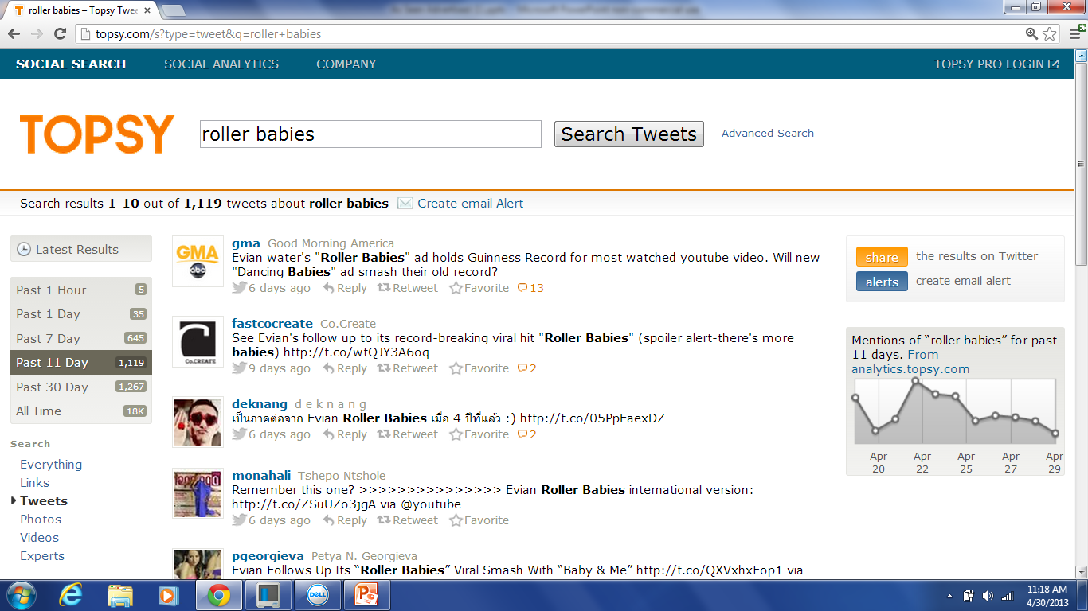
Topsy

Slide 5
analysis
The purpose of our analysis is to determine viewer sentiment towards each method of advertising. We have each selected a collection of three advertisements which we feel best represent our respective categories.
The measure of viewer sentiment was accomplished by comparing each ad against the others within its category based on tweets and the YouTube comments from the specific commercials under review. The outcomes were then summarized and each category compared against each other.
Total YouTube views for each category were summarized and compared
Lastly, graphs were prepared on an effort to depict a correlation between increased tweet traffic and stock prices

Slide 6
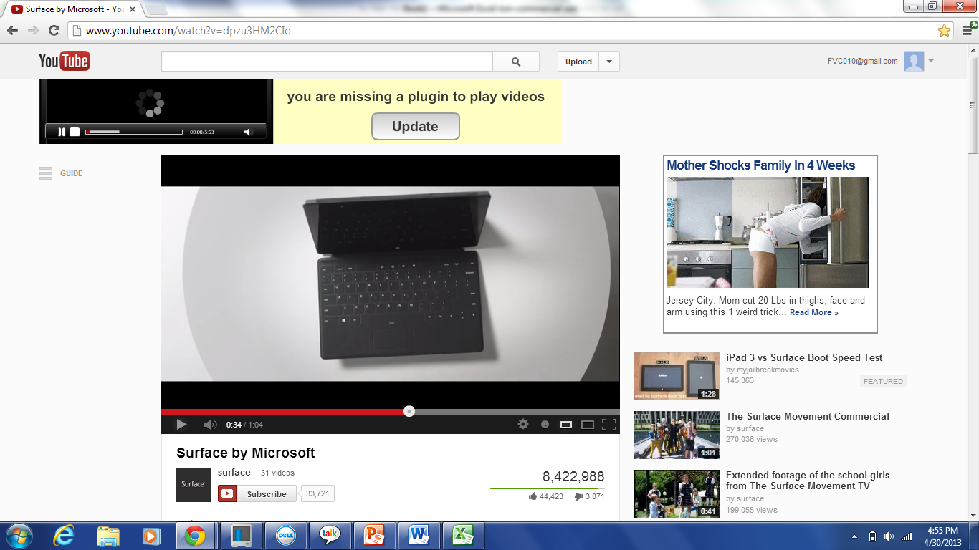
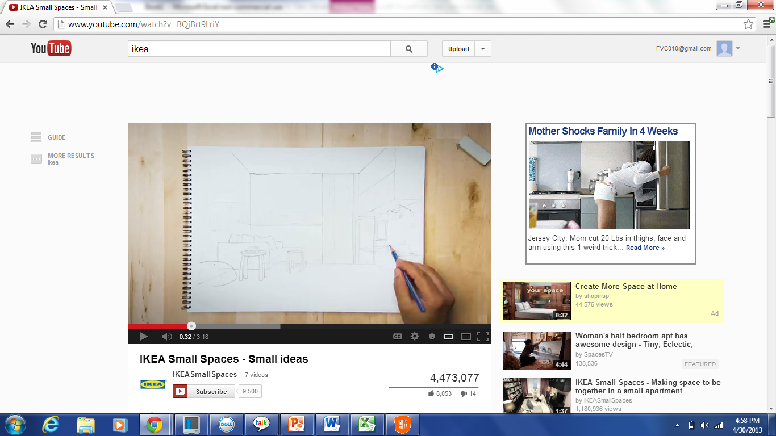
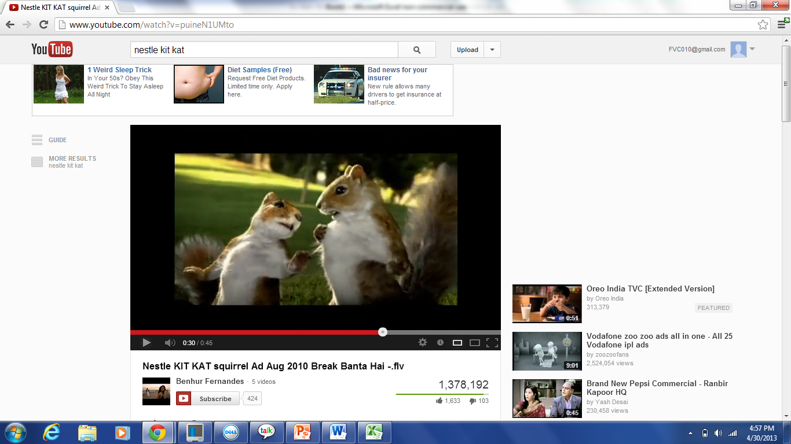
tv commercials

Slide 7
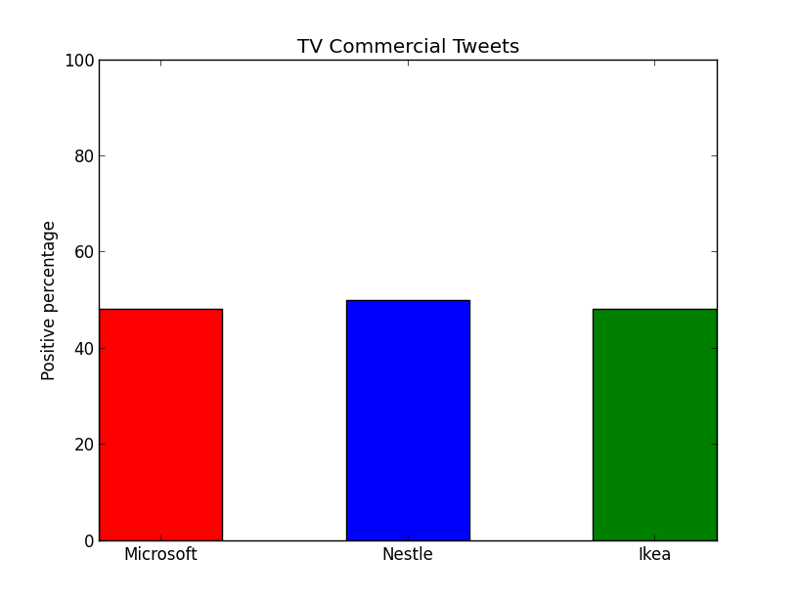
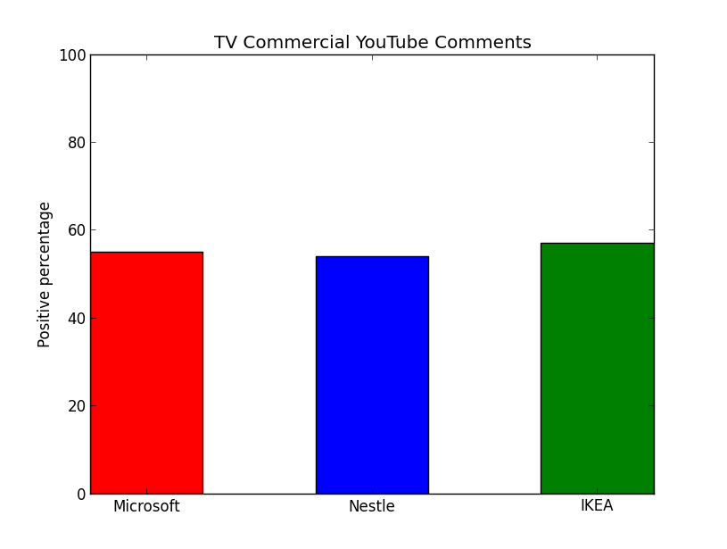
TV Commercials Tweet & YouTube Sentiments
Notes:
Tweets Pos Neg Total
Miros 1583 1700 3283
Nestle 1862 1871 3733
Ikea 1325 1443 2768 %
Total 4770 9784 0.487531
YouTube Pos Neg Total
Miros 3222 2635 5857
Nestle 373 313 686
Ikea 592 443 1035 %
Total 4187 7578 0.55252

Slide 8
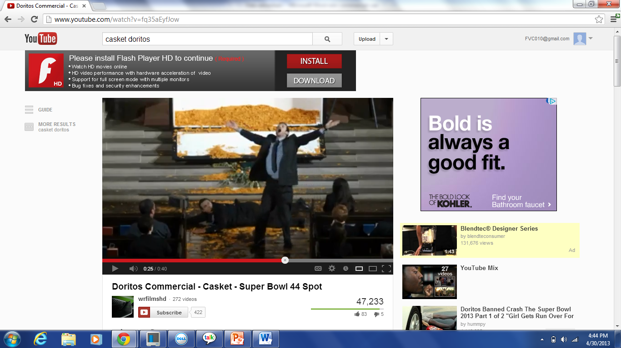
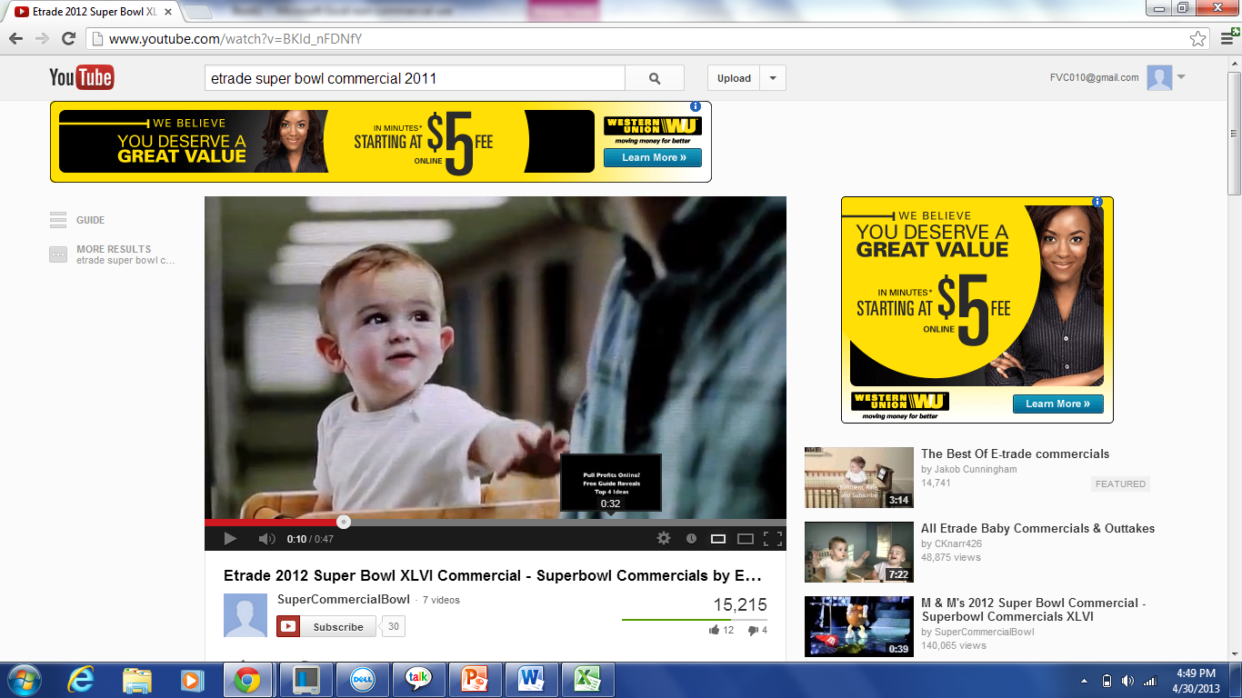
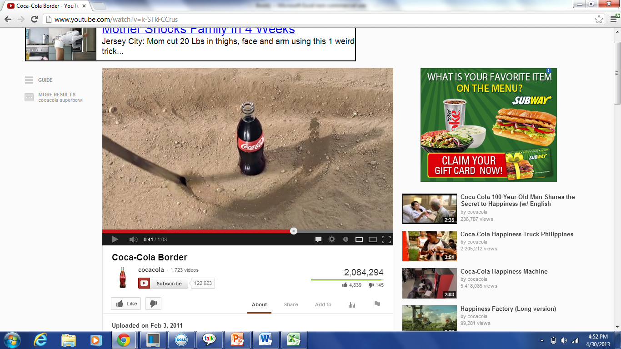
Super bowl commercials

Slide 9
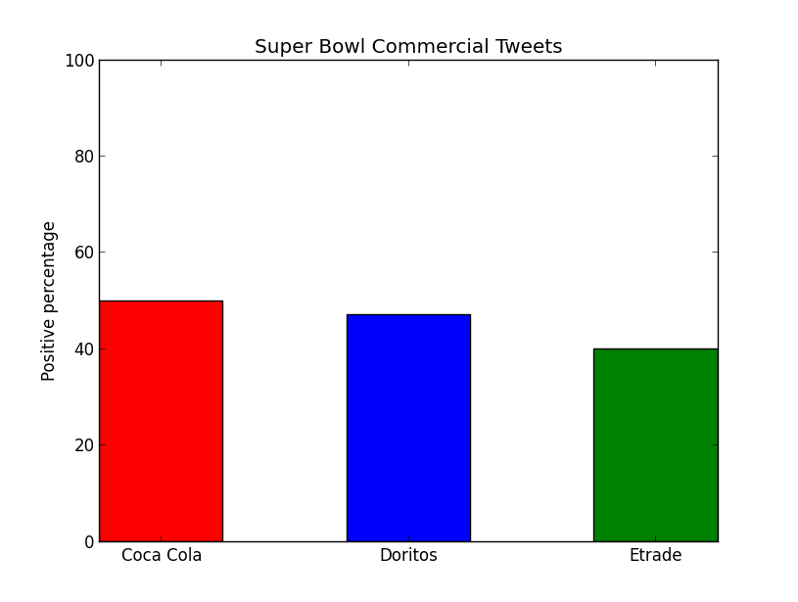
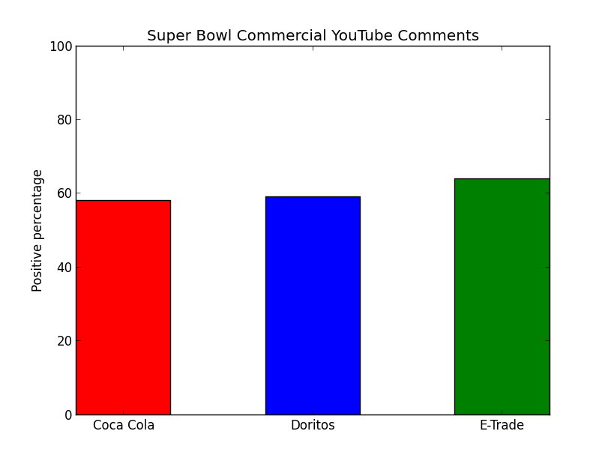
Super Bowl commercials Tweet & YouTube Sentiments
Notes:
Tweets Pos Neg Total
coca cola 1511 1518 3029
Doritos 1234 1394 2628
Etrade 807 1235 2042 %
Total 3552 4147 7699 0.461359
YouTube Pos Neg Total
coca cola 505 366 871
Doritos 1695 1178 2873
Etrade 14 8 22 %
Total 2214 3766 0.587892

Slide 10
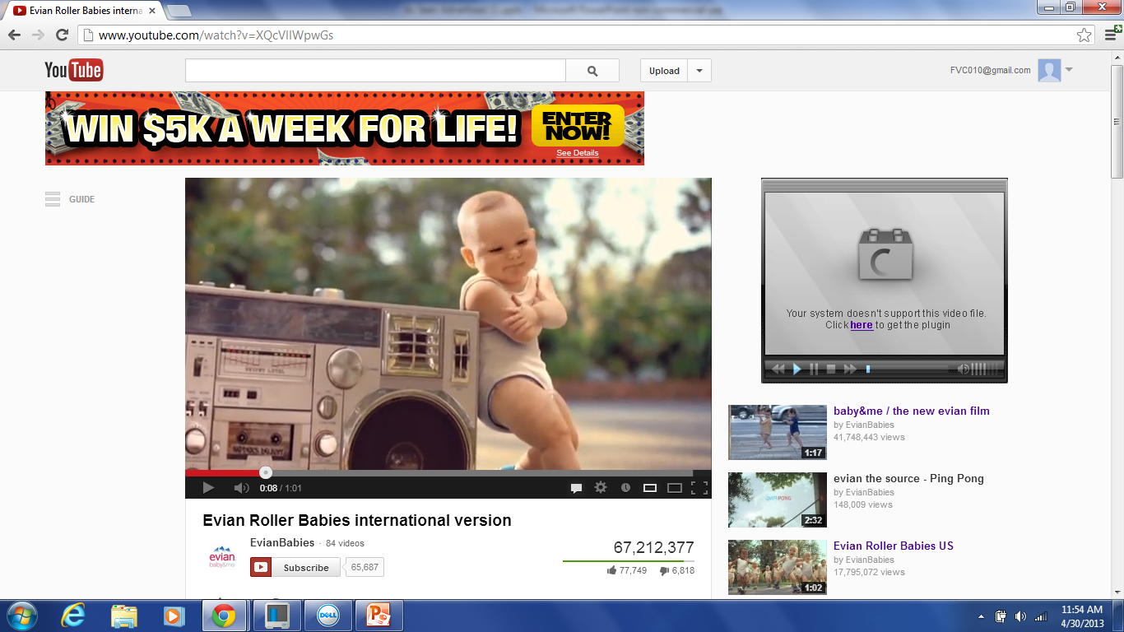
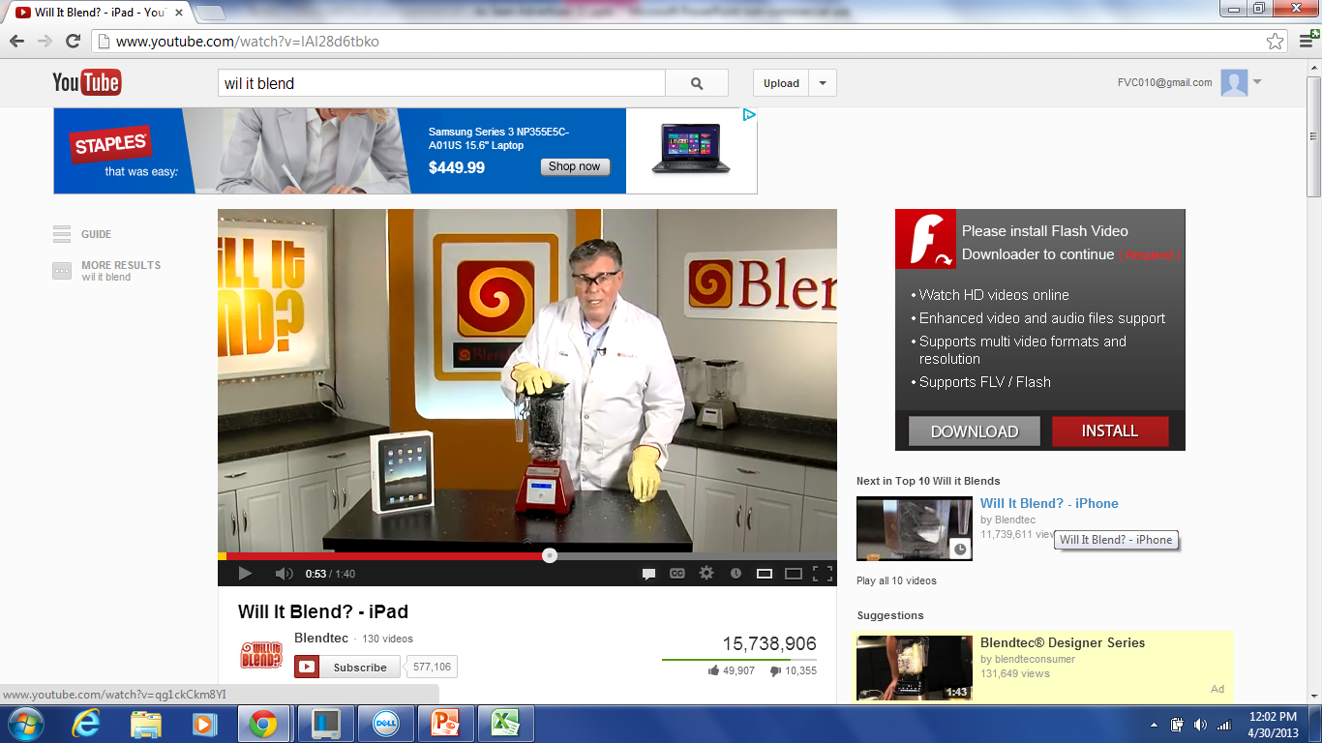
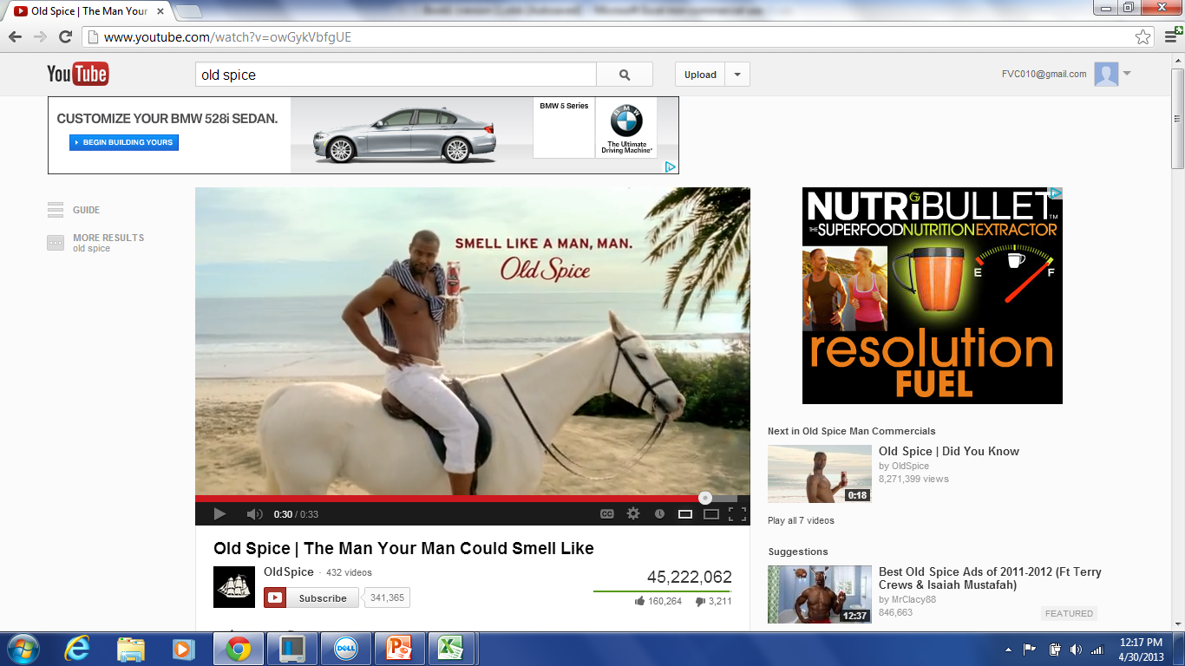
Web commercials

Slide 11
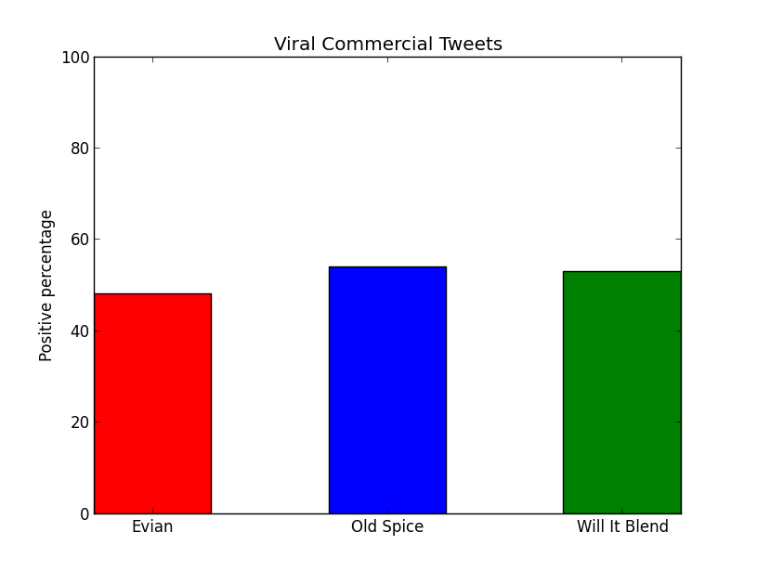
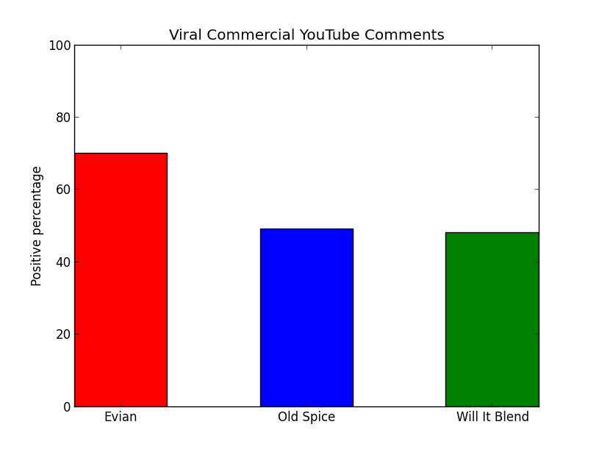
Web Commercials Tweet & YouTube Sentiments
Notes:
Tweets Pos Neg Total
Evian 1080 1154 2234
Old Spice 1424 1228 2652
will it blend 3801 3381 7182 %
Total 6305 12068 0.522456
YouTube Pos Neg Total
Evian 1122 474 1596
Old Spice 1327 1408 2735
will it blend 1532 1680 3212 %
total 3981 7543 0.527774

Slide 12
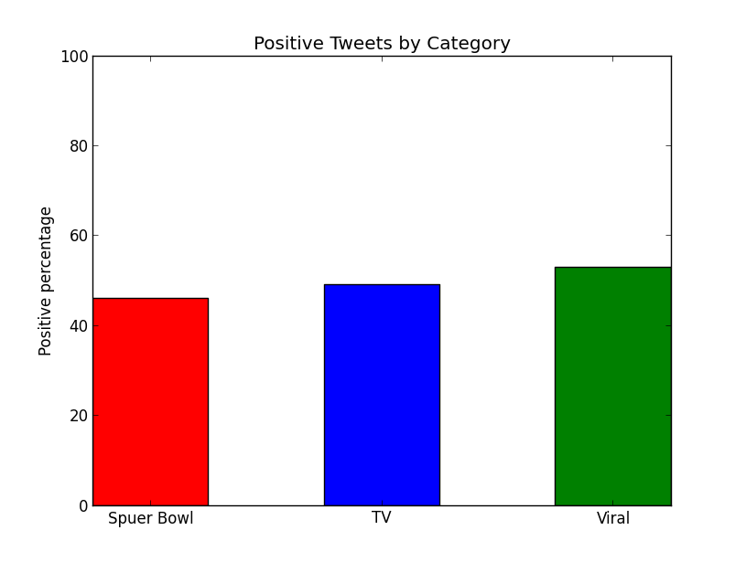
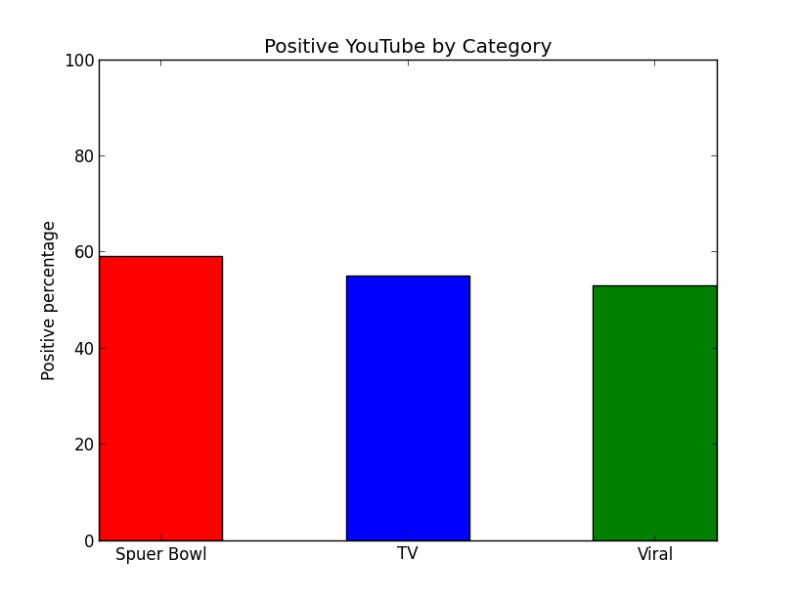
Sentiment Analysis Totals
Notes:
Tweet Totals
Super Bowl - %0.461359
TV - %0.487531
Viral - %0.522456
YouTube Totals
Super Bowl - % 0.587892
TV - % 0.55252
Viral - % 0.527774

Slide 13
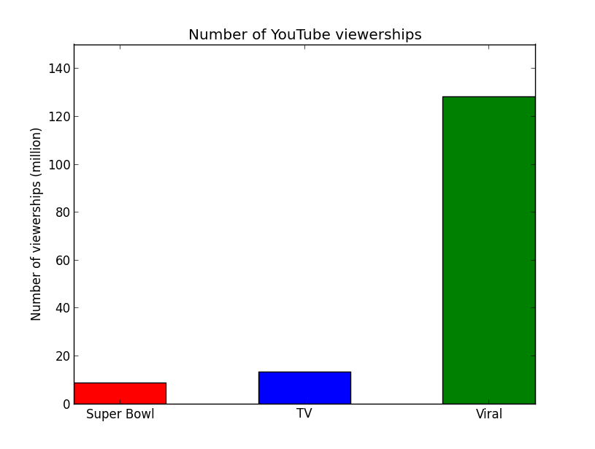
YouTube Viewership Totals
Notes:
Super Bowl YouTube videos/views for 2010
2010
Doritos "Underdog" 451,113
Doritos "House_Rules" 36,808
Coca-Cola "Hard Times" 5,972,459
Doritos "Casket" 47,098
Coca-Cola "Sleepwalker" 1,192,924
E*Trade "Girlfriend" 934,361
Doritos "Snack-Attack_Samurai" 38,018 (Nielson - 116,231,920)
E*Trade "Tears" 48,868 (Nielson - 112,727,440)
Super bowl: 8,721,649
TV ( I add the three most viewed videos) :13,123,285
Viral: 132,000,000

Slide 14
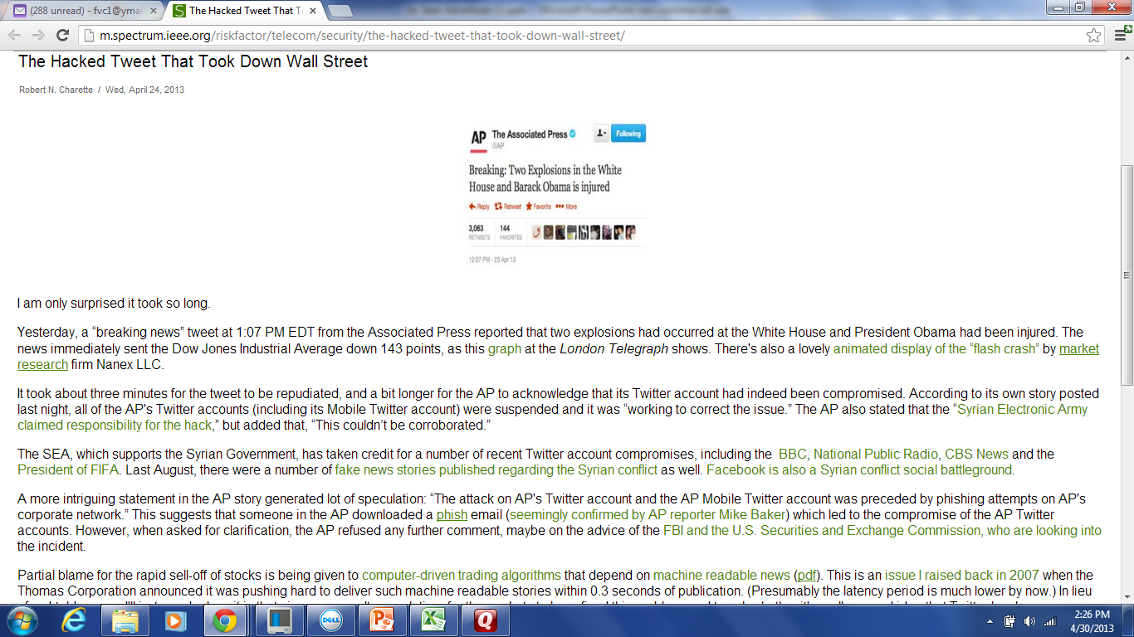
The hacked tweet that took down wall street

Slide 15
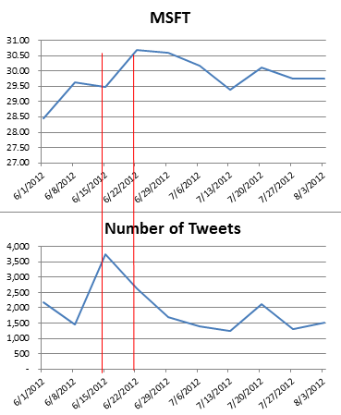
Microsoft Tweet Traffic vs. Stock Price

Slide 16
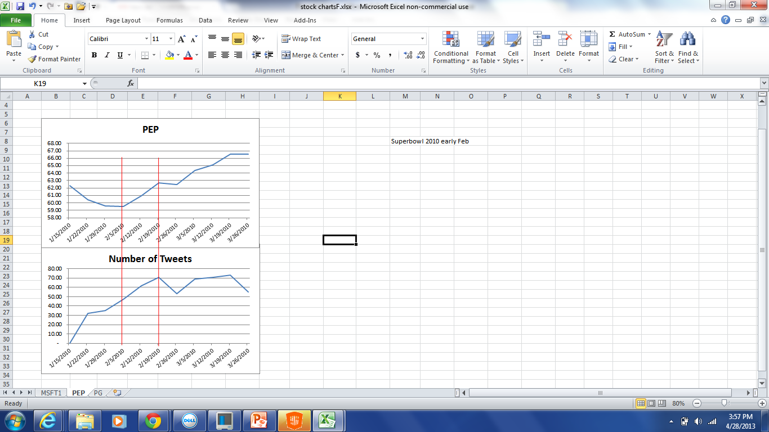
Doritos Tweet Traffic vs. Stock Price

Slide 17
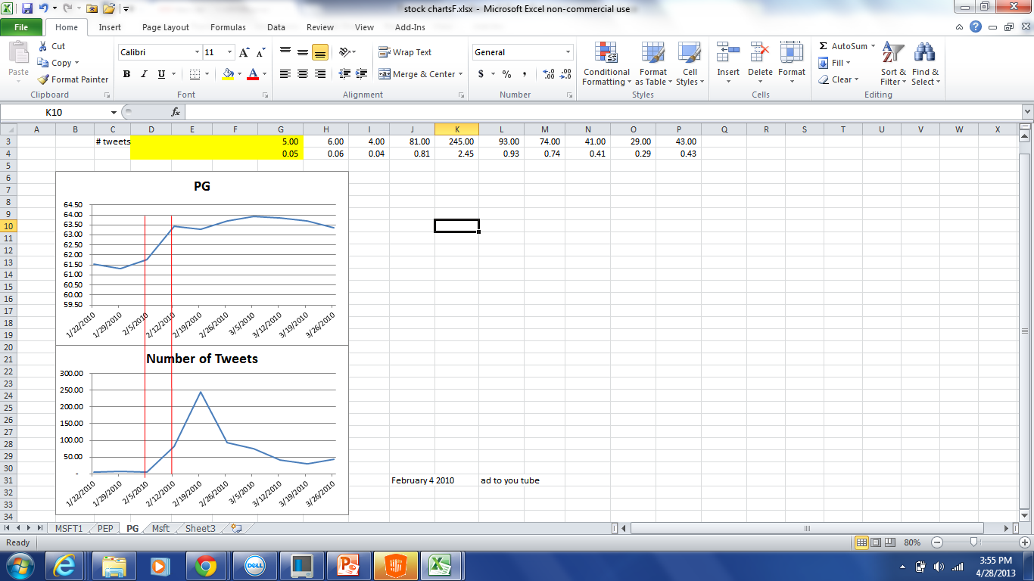
Old spice Tweet Traffic vs. Stock Price

Slide 18
Recommendations
We, the marketing team, recommend our company “As Seen Advertised’ to use a Viral method of advertising.
Our analysis showed:
Total Tweet sentiments - Viral showed the highest percentage of positive tweets
Total YouTube comments – Super Bowl showed the highest percentage of positive comments
YouTube Viewership – Viral showed the highest number of Views
Viewership is undisputable.
Cost of Viral vs. Super Bowl – Viral is attractive for start-ups

Slide 19

Questions

